Slide 1
Chapter 39

Slide 2
If slides with embedded WMF files do not have text properly aligned and fitting within the text boxes, this would indicate that you do not have Helvetica font installed on your computer, and Arial font has been substituted by default. Reinstalling Helvetica will most likely solve the problem.

Slide 3
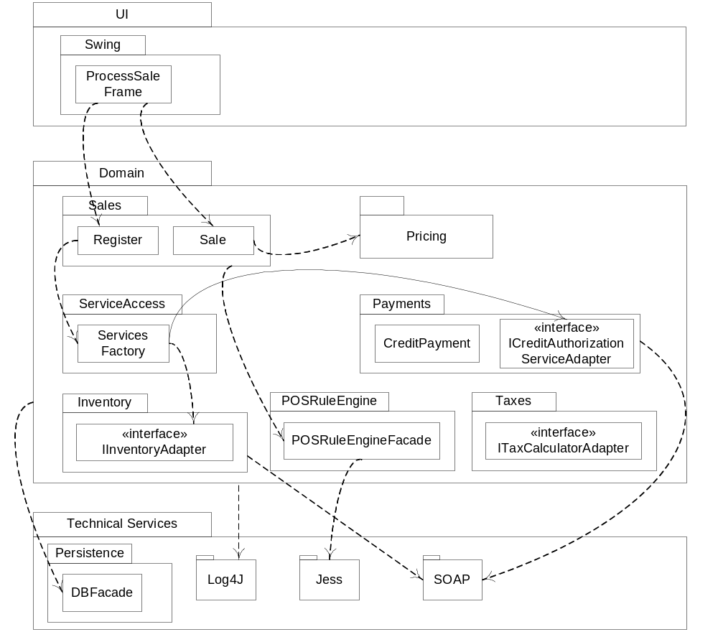
Example A Fig. 39.1

Slide 4
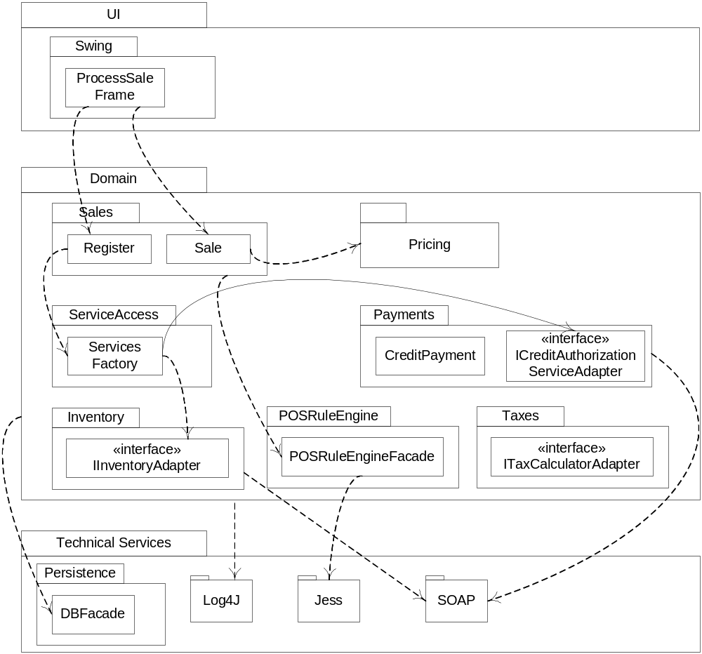

Example A Fig. 39.1

Slide 5
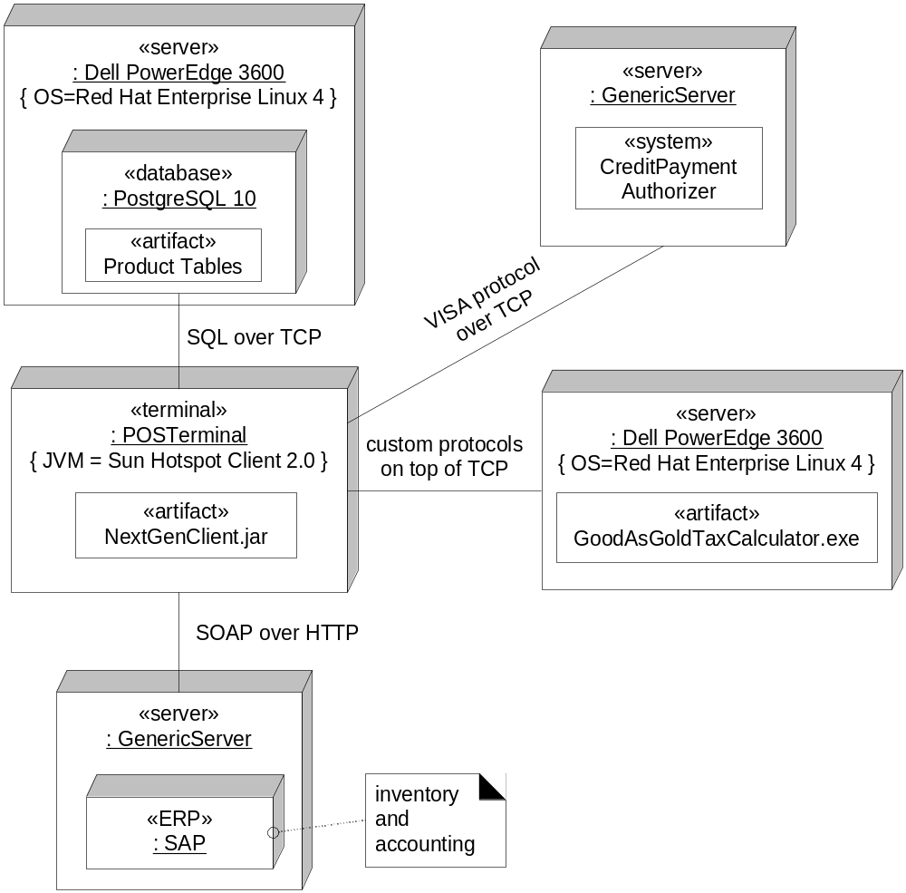
Example A Fig. 39.2

Slide 6
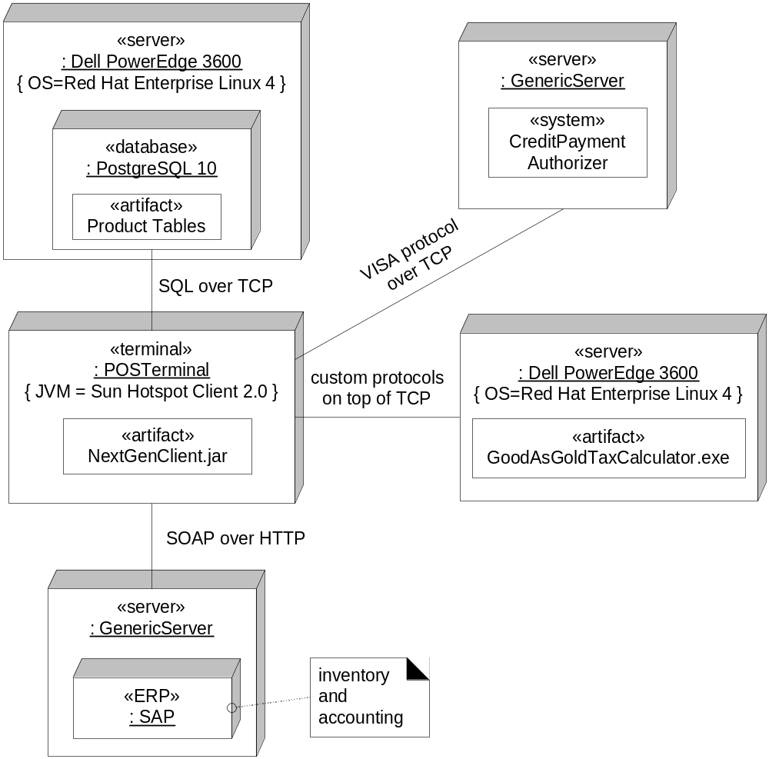
Example A Fig. 39.2

Slide 7
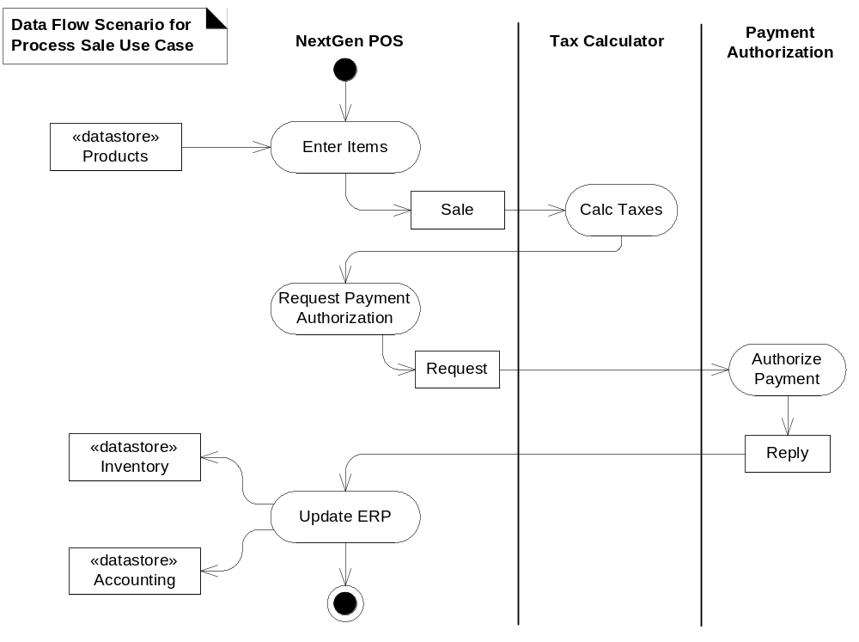
Example A Fig. 39.3

Slide 8
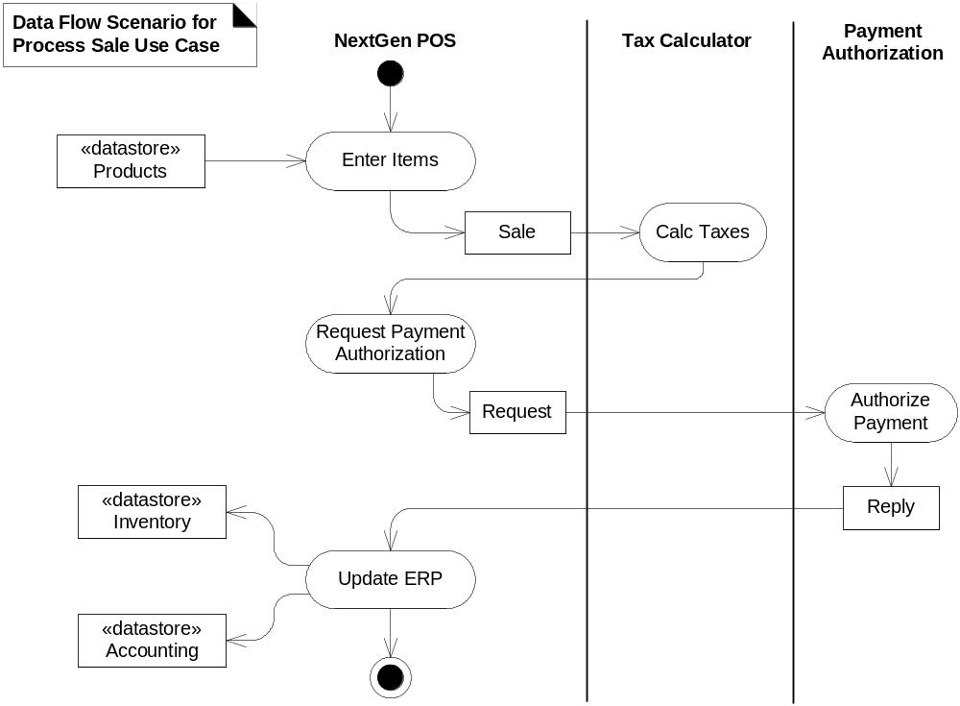
Example A Fig. 39.3

Slide 9
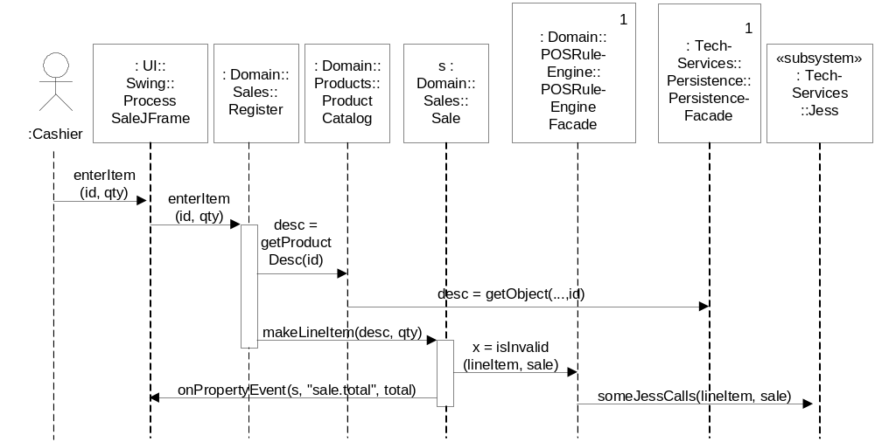
Example A Fig. 39.4

Slide 10
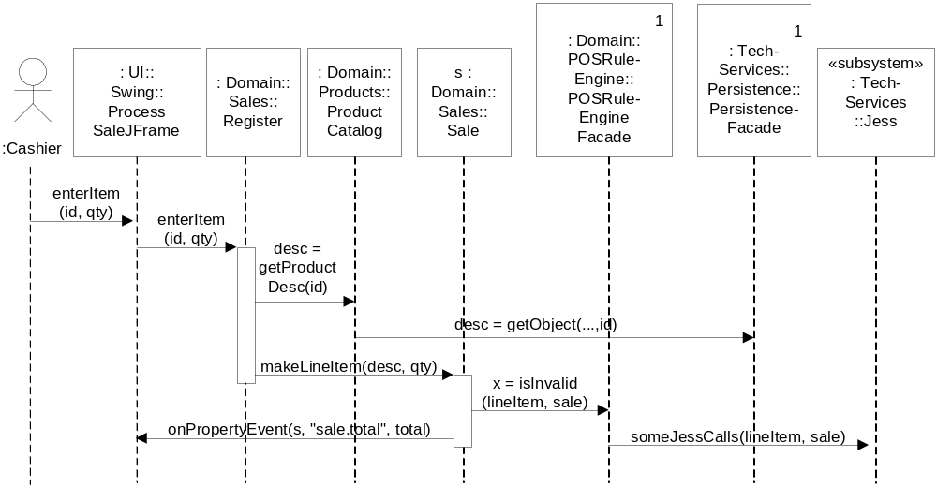
Example A Fig. 39.4

Slide 11
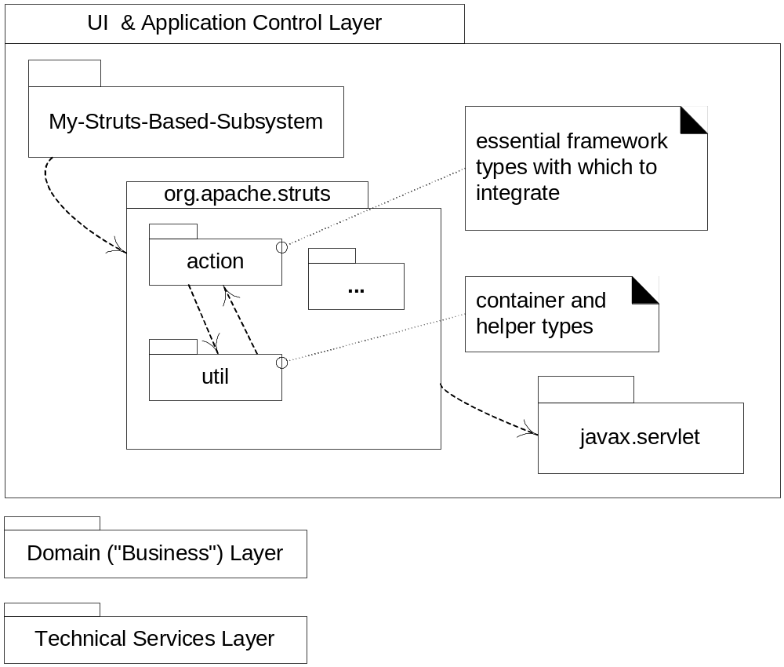
Example B Fig. 39.1

Slide 12

Example B Fig. 39.1

Slide 13
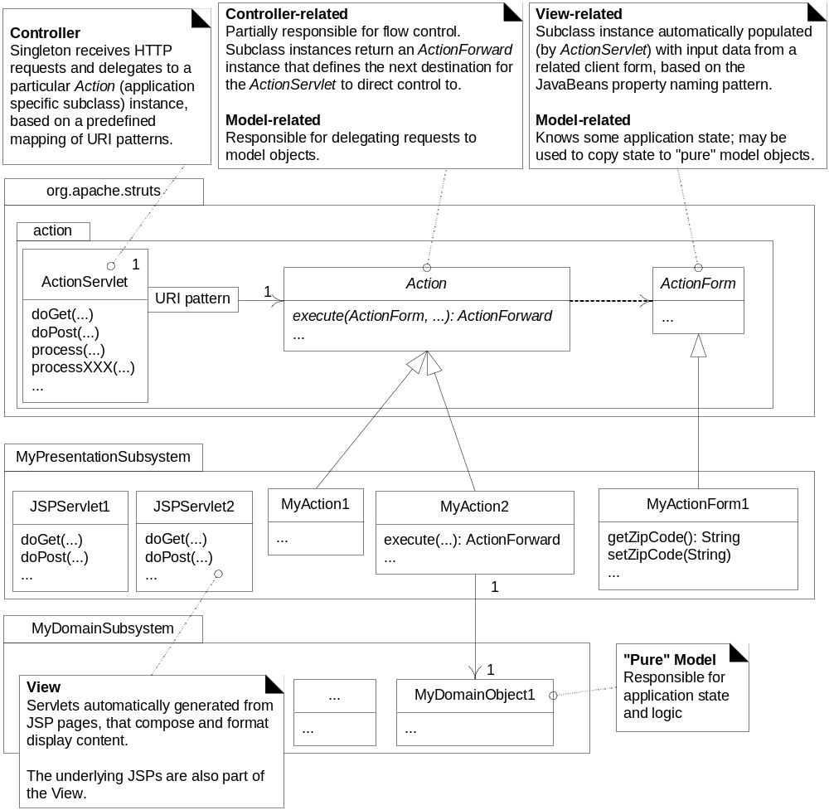
Example B Fig. 39.2

Slide 14

Example B Fig. 39.2

Slide 15
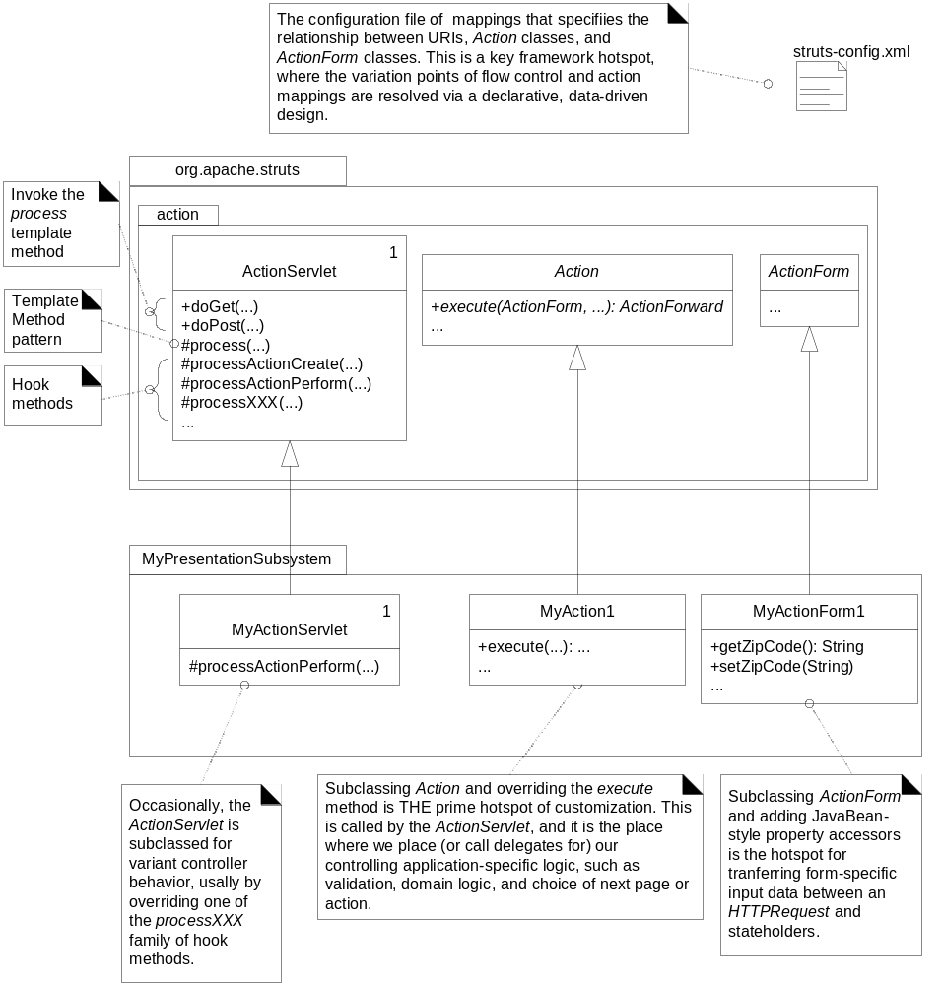
Example B Fig. 39.3

Slide 16
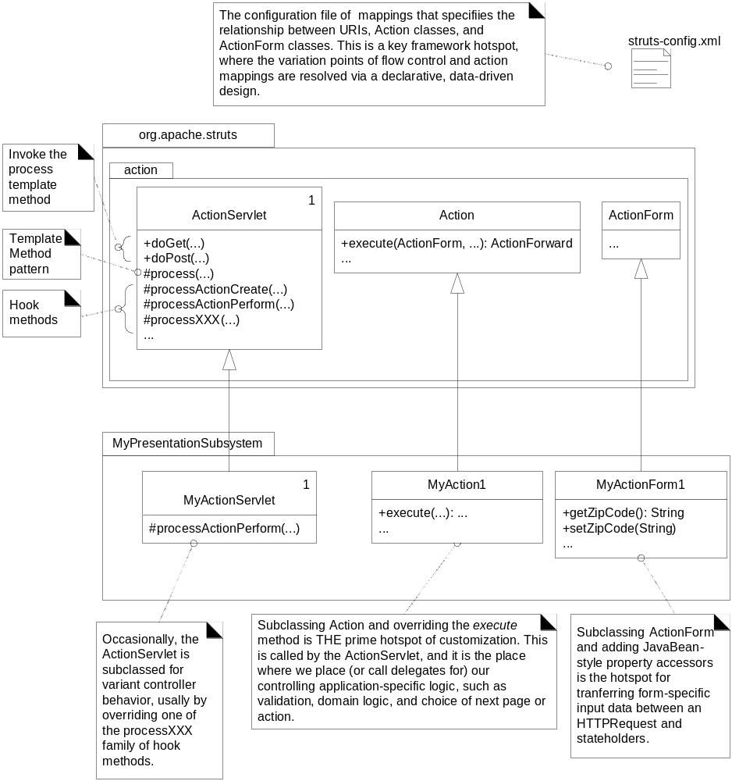
Example B Fig. 39.3

